Slide 1
Git & GitHub:
An Introduction To Version Control
Justin DeMayo, System and Application Specialist
Slides: https://github.com/CWML/gitdemo
Notes:
Intro
Git/GitHub Knowledge ?
Show of hands how many people currently use github.com…github desktop…git in the terminal?

Slide 2
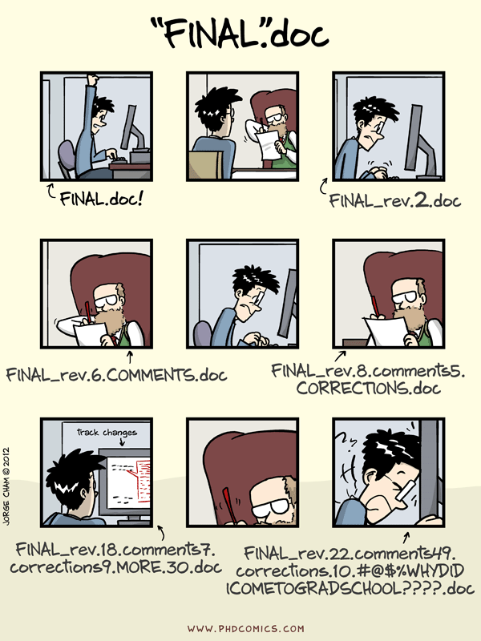
Why?
“notFinal.doc” by Jorge Cham,
https://www.phdcomics.com
Notes:
We’ve all been in this situation before: it seems unnecessary to have multiple nearly-identical versions of the same document. Some word processors let us deal with this a little better, such as Microsoft Word’s Track Changes, Google Docs’ version history, or LibreOffice’s Recording and Displaying Changes.
Before we talk about version control, we’re going to talk about Git & GitHub

Slide 3

git
git is a command line program
Distributed version control system
Created by Linus Torvalds in 2005 who also created the Linux kernel.
World's most popular VCS
Benefits:
Local and Remote Repositories
Branching Capabilities
Reliability with multiple copies
Flexible workflows
Allows for private or draft work before sharing with peers
Notes:
Git accomplishes version control by creating a repository in a selected folder on your computer.
In software development, distributed version control a form of version control in which the complete codebase, including its full history, is mirrored or distributed on every developer's computer.
It enables multiple developers to work on a single project simultaneously, managing and tracking changes to the codebase over time. These modern systems also include powerful merging tools that make it possible for multiple authors to work on the same files concurrently.
Benefits
• **Local and Remote Repositories:** Git allows distributed version control, enabling users to work locally and then push changes to a remote repository.
• **Branching Capabilities:** Supports branching and merging, allowing you to diverge from the main line of development and create alternate versions of files and directories.
• **Flexibility in Workflows:** Git supports various workflows such as centralized, feature branch, Gitflow, and Forking, providing flexibility depending on the project needs.

Slide 4

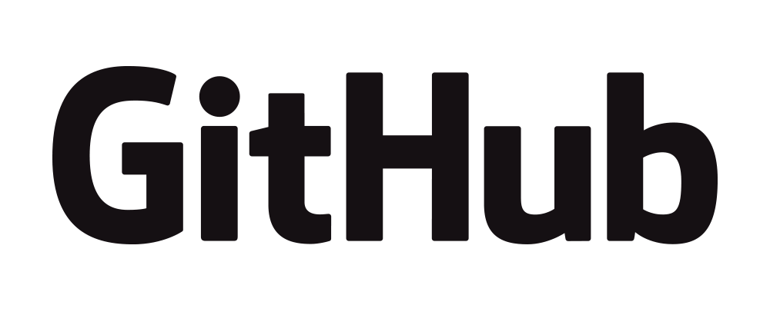
GitHub
Web/Desktop based platform that utilizes the git VCS
Provides Graphical User Interface
Storage of git repositories enables collaborative use
Hosts millions of open-source projects
Codespaces virtual environment for development
GitHub pages & projects
Benefits:
Collaboration
Project Management
Integration – VSCode & more
Documentation
Notes:
GitHub is a web-based platform that provides version control using Git.
Github Desktop provides a graphical interface on top of Git's command-line tooling, making it more accessible to a wider range of users.
GitHub repositories also function as backups of your work while allowing you to collaborate with others if necessary.
Hosts millions of open-source projects, fostering a large developer community.
Codespace: Each is hosted by GitHub in a Docker container, running on a virtual machine.
Development platform, free initial use, pay by use after.
Pages:
Websites for projects. Hosted directly from your GitHub repository.
Benefits
• **Collaboration:** Facilitates easier collaboration among project team members and is used extensively for open source projects.
• **Project Management Tools:** Integrates issue tracking, code reviewing, and a project management dashboard.
• **Integration:** Offers integration with many tools and platforms, enhancing the development process.
• **Documentation:** Provides a platform for hosting project documentation which can be directly linked to the source code.
GitHub is more than just a repository for code; it's a comprehensive platform that supports the entire software development lifecycle. Additionally, its versatile features make it an excellent tool for non-code related projects, enhancing collaboration, organization, and management across various fields.

Slide 5
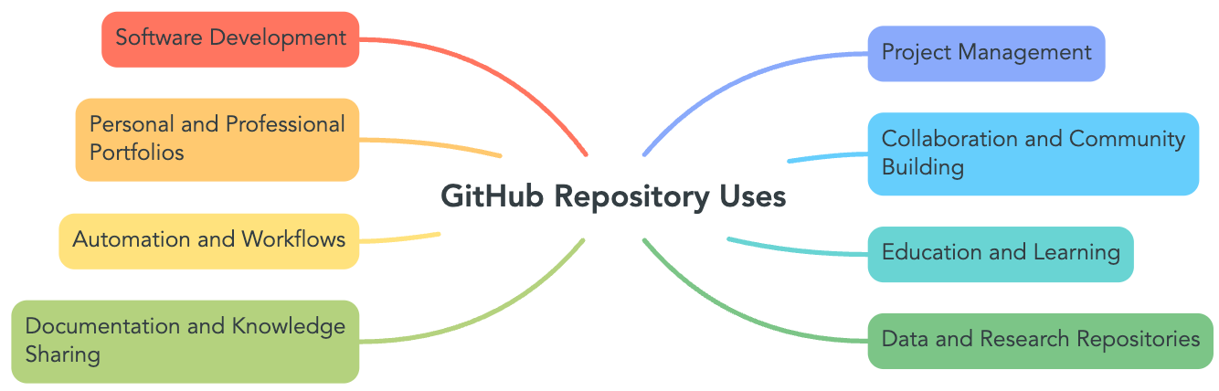
Use Cases
Notes:
While one of the main use cases of github repositories and github.com is software development there are many ways it can be utilized as illustrated in this wordmap.

Slide 6
Version Control
Version control is a system that records changes to a file or set of files over time so that you can recall specific versions later.
Track modifications, and collaborate on projects without overwriting other’s work.
Benefits:
Backup and Restore
Synchronization
Short/Long Term Undo
Branching and Merging
Notes:
So, what is version control and why should I use it?
Def: Version control is a system that records changes to a file or set of files over time so that you can recall specific versions later.
Purpose: It helps in tracking modifications, enabling multiple people to collaborate on the same project without overwriting each other’s work.

Slide 7
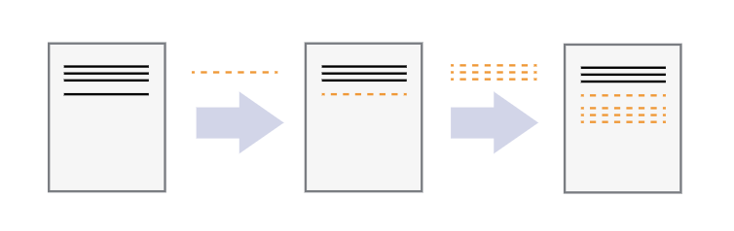
Record Changes
Notes:
Version control systems start with a base version of the document and then record changes you make each step of the way. You can think of it as a recording of your progress: you can rewind to start at the base document and play back each change you made, eventually arriving at your more recent version.
Changes are separate from your document.

Slide 8
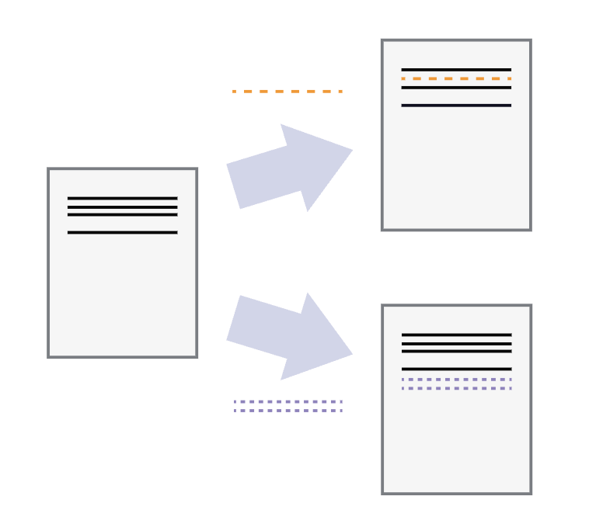
Versions
Notes:
Once you think of changes as separate from the document itself, you can then think about “playing back” different sets of changes on the base document, ultimately resulting in different versions of that document. For example, two users can make independent sets of changes on the same document.

Slide 9
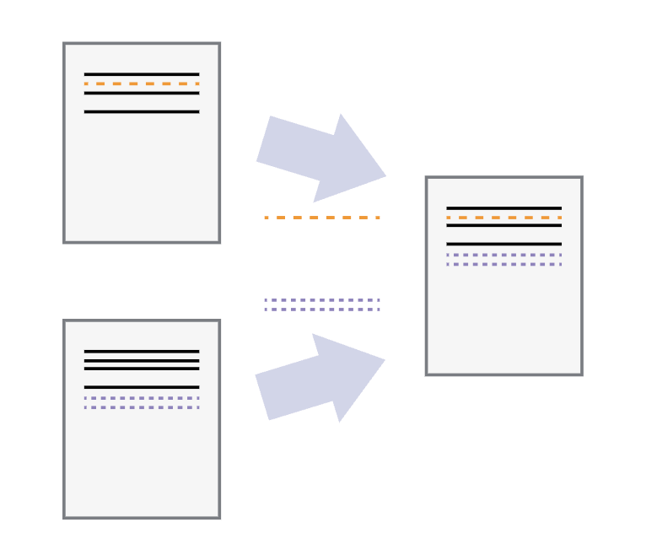
Merge changes
Notes:
Unless multiple users make changes to the same section of the document - which is called a conflict - you can incorporate two sets of changes into the same base document.
A version control system is a tool that keeps track of these changes for us, effectively creating different versions of our files. It allows us to decide which changes will be made to the next version (each record of these changes is called a commit), and keeps useful metadata about them. The complete history of commits for a particular project and their metadata make up a repository. Repositories can be kept in sync across different computers, facilitating collaboration among different people.
Version control is like an unlimited ‘undo’.
Version control also allows many people to work in parallel.

Slide 10
git in the terminal
https://github.com/CWML/gitdemo

Slide 11
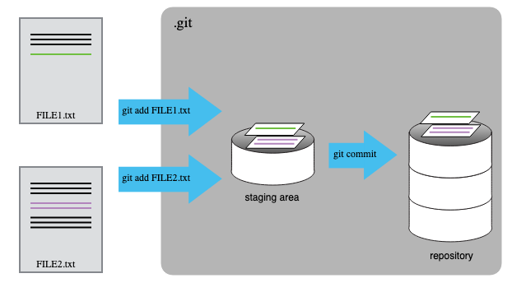
Staging Area
Notes:
Use for demonstrating staging area during git terminal demo
git undo commit

Slide 12
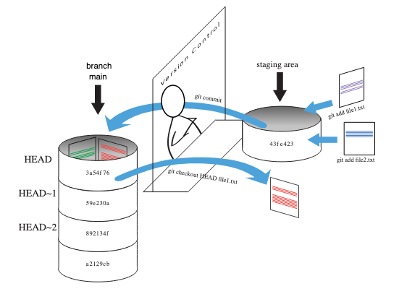
Staging area
Notes:
cat ~/.ssh/id_rsa.pub
^ how to copy your ssh key
This graphic represents

Slide 13
Further learning
GitHub Documentation
https://try.github.io/
Software Carpentry Git Novice workshop
https://swcarpentry.github.io/git-novice/
GitHub Cheat Sheet
https://training.github.com/downloads/github-git-cheat-sheet.pdf
How to contribute to open source
https://open-source-for-researchers.github.io/open-source-workshop/
Yale Research Computing Git Workshop Video Recording
https://research.computing.yale.edu/training/version-control-git

Slide 14
Attribution
This workshop was adapted from the following source:
Version Control with Git
Ivan Gonzalez; Daisie Huang; Nima Hejazi; Katherine Koziar;
Madicken Munk (eds): "Software Carpentry: Version Control with Git."
Version 2019.06.1, July 2019,
https://github.com/swcarpentry/git-novice, 10.5281/zenodo.3264950

Slide 15
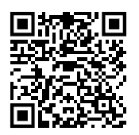
Take the class Survey!
It’s only 4 questions!
https://tinyurl.com/gitintrosurvey
Scan for survey!

